Slide 1
Object Oriented Programming Lecture-8
use of Scanner Class, scanner vs BufferReader Class, Formatted output, Reading input from console.
Prof. Varsha Dange

Slide 2
Scanner Class
Scanner in Java is a predefined class that reads or scans the data dynamically from the keyboard or a text file.
Scanner is a class in java.util package used for obtaining the input of the primitive types like int, double, etc. and strings.
To create an object of Scanner class, we have to pass the predefined object System.in, which represents the standard input stream.
We may pass an object of class File if we want to read input from a file.

Slide 3
Java Scanner class methods
Method | Description
nextBoolean() | Reads a boolean value from the user
nextByte() | Reads a byte value from the user
nextDouble() | Reads a double value from the user
nextFloat() | Reads a float value from the user
nextInt() | Reads a int value from the user
nextLine() | Reads a String value from the user
nextLong() | Reads a long value from the user
nextShort() | Reads a short value from the user
next() | Reads a string(one word) value from the user
close() | It closes the stream.

Slide 4
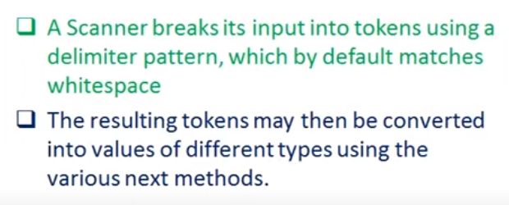
How does Java Scanner read Input from keyboard?
Import java.util.Scanner class
Create object of Scanner class
Use built-in methods to take input.
Example

Slide 5
Java Scanner class hasNext methods
Method | Description Example
hasNext() | It returns true if this scanner has another token in its input
hasNextBoolean() | It is used to check if the next token in this scanner's input can be interpreted as a boolean using the nextBoolean() method or not.
hasNextDouble() | It is used to check if the next token in this scanner's input can be interpreted as a double using the nextDouble() method or not.
hasNextFloat() | It is used to check if the next token in this scanner's input can be interpreted as a float using the nextFloat() method or not.
hasNextInt() | It is used to check if the next token in this scanner's input can be interpreted as an int using the nextInt() method or not.
hasNextLine() | It is used to check if there is another line in the input of this scanner or not.
hasNextLong() | It is used to check if the next token in this scanner's input can be interpreted as a long using the nextLong() method or not.
hasNextShort() | It is used to check if the next token in this scanner's input can be interpreted as a short using the nextShort() method or not.
hasNextByte() | It is used to check if the next token in this scanner's input can be interpreted as a byte using the nextByte() method or not.

Slide 6
BufferedReader Vs Scanner
Sr. No. | Key | Scanner Class | BufferReader Class
1 | Synchronous | Scanner is not synchronous in nature and should be used only in single threaded case. | BufferReader is synchronous in nature. During multithreading environment, BufferReader should be used.
2 | Buffer Memory | Scanner has smaller buffer of 1 KB char buffer. | BufferReader has large buffer of 8KB byte Buffer as compared to Scanner.
3 | Processing Speed | Scanner is bit slower as it need to parse data as well. | BufferReader is faster than Scanner as it only reads a character stream.
4 | Methods | Scanner has methods like nextInt(), nextShort() etc. | BufferReader has methods like parseInt(), parseShort() etc.
5 | Read Line | Scanner has method nextLine() to read a line. | BufferReader has method readLine() to read a line.

Slide 7
Console Class
Console in Java is a utility class in java.io package that provides access to the system console associated with JVM.
Console class was introduced in Java 1.6 version.
It is mainly used for reading data from the console and writing data on the console.
The Console class is defined in the java.io class which needs to be imported before using the console class.
It does not work in a non-interactive environment (such as in an IDE).
Method | Description
String readLine() | This method reads a single line of text from the console.
char[ ] readPassword() | It is used to read a password that is visible on the console screen.

Slide 8
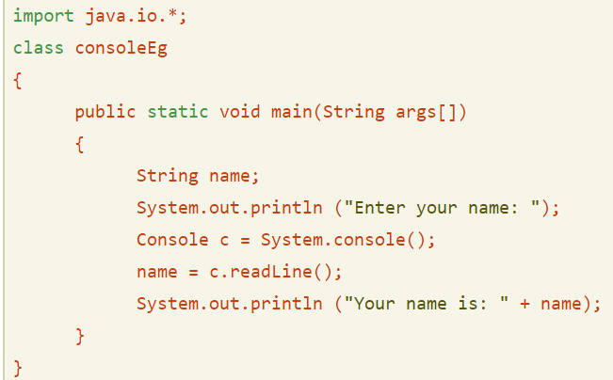
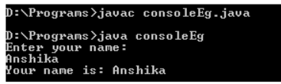
Console Class
Example1
Example2

Slide 9
Formatted output in java
You can format the way that output appears by using the printf() method.
The first argument of the printf() is called format string.
It specifies the format of the text to be printed and may contain placeholder called format specifiers which begin with a % sign.
There are also format sub-specifiers to further format the value’s appearance.

Slide 10
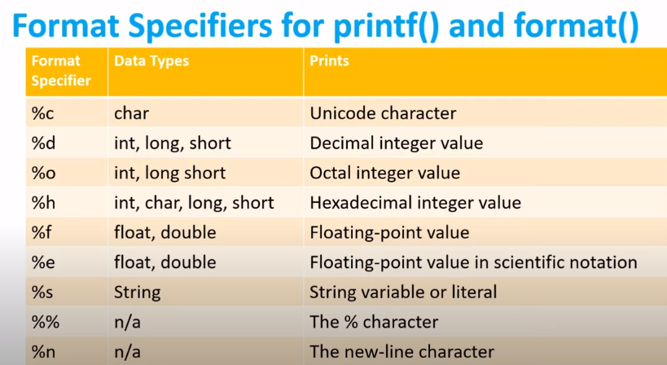
Formatted output in java
Example

